Slide 1
IR Evaluation: Designing an End-to-End Offline Evaluation Pipeline (2)
Jin Young Kim, Microsoft
jink@microsoft.com
Emine Yilmaz, University College London
emine.yilmaz@ucl.ac.uk

Slide 2

Speaker Bio
Graduated from UMass Amherst with Ph.D in 2012
Spent past 3 years in Bing’s Relevance Measurement / Science Team
Taught MSFT course on offline evaluation
Passionate for working with data of all kinds (search, personal, baseball, …)

Slide 3
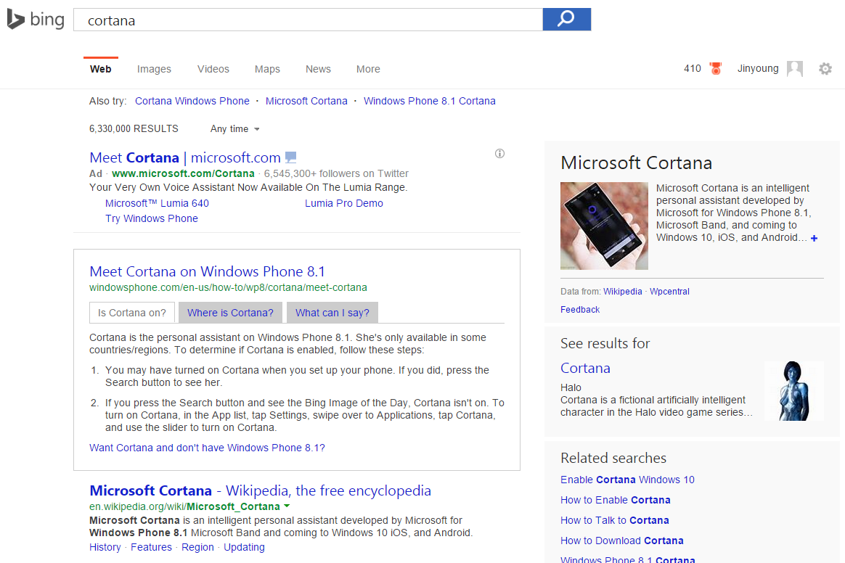
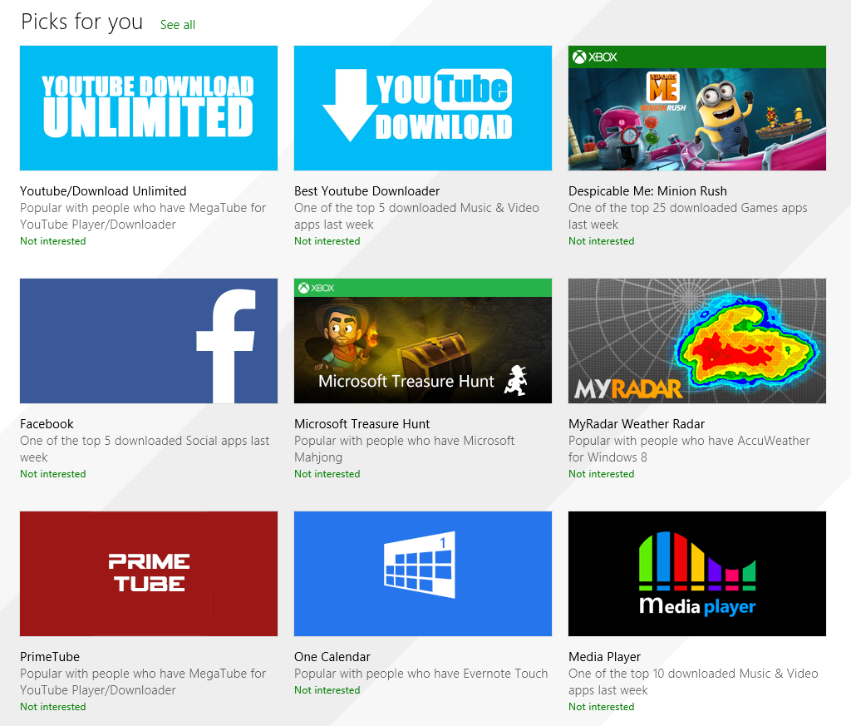
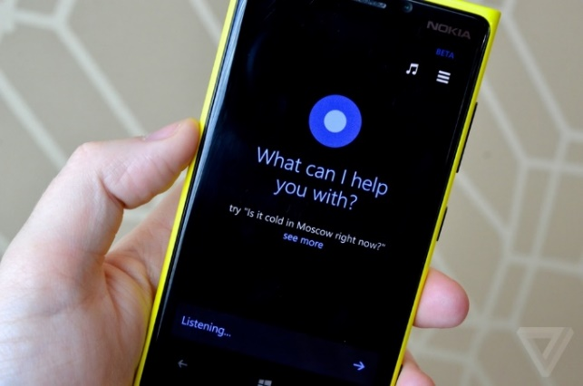
Evaluating a Data Product
How would you evaluate Web Search, App Recommendations, and even an Intelligent Agent?
Notes:
Different from software evaluation:
Output depends on task & user / Subjective quality

Slide 4

Better Evaluation = Better Data Product
Investment decisions
Shipping decisions
Compensation decisions
More effective ML models
Notes:
Evaluation is critical in every stages of development
Harry Shum: ‘We are as good as having the perfect WSE if we perfect the evaluation’

Slide 5
Tutorial Objective
Overview End-to-End process of how evaluation works in a large-scale commercial web search engine
Learn about various decisions and tips for each step
Practice designing a judging interface for specific task
Review related literature in various fronts
Notes:
Compared to Pt.1 where Emine focused on Academic IR evaluation, I’ll focus on what people in industry care about

Slide 6
What Makes Evaluation in Industry different?
Larger scale / team / business at stake
More diverse signals for evaluation (online + offline)
More diverse evaluation targets (not just documents)
Need for a sustainable evaluation pipeline

Slide 7
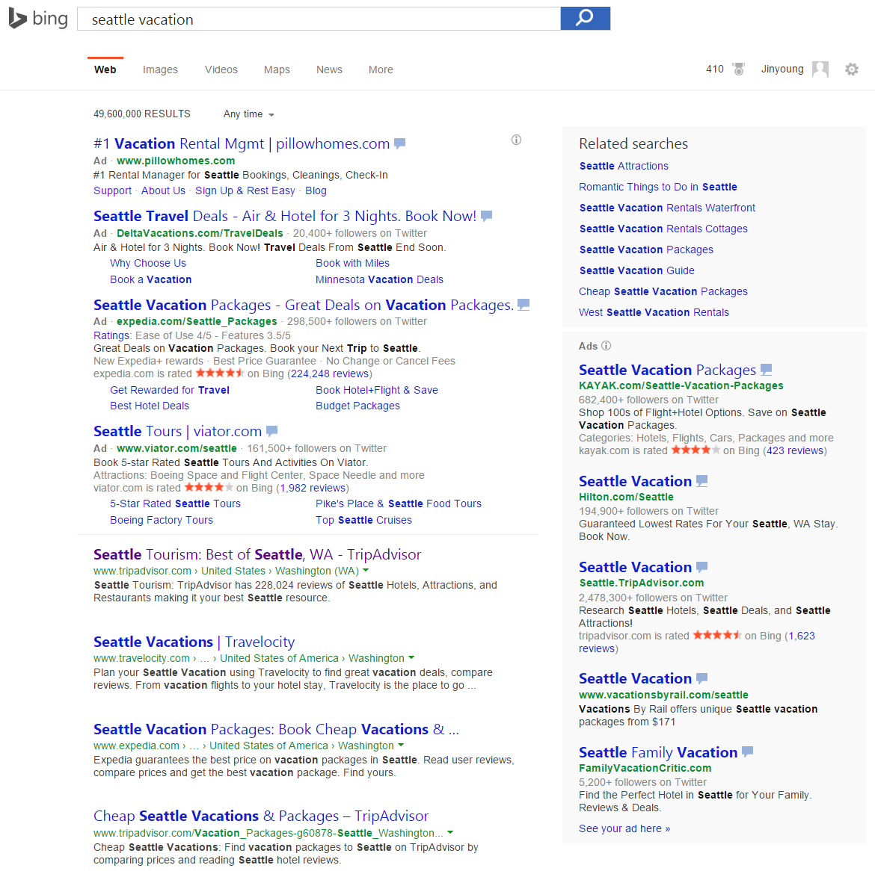
Agenda: Steps for Offline Evaluation
Preparing tasks
Designing a judging interface
Designing an experiment
Running the experiment
Evaluating the Experiment
Notes:
For the rest of this talk, I’ll follow the steps for …

Slide 8
Preparing tasks

Slide 9
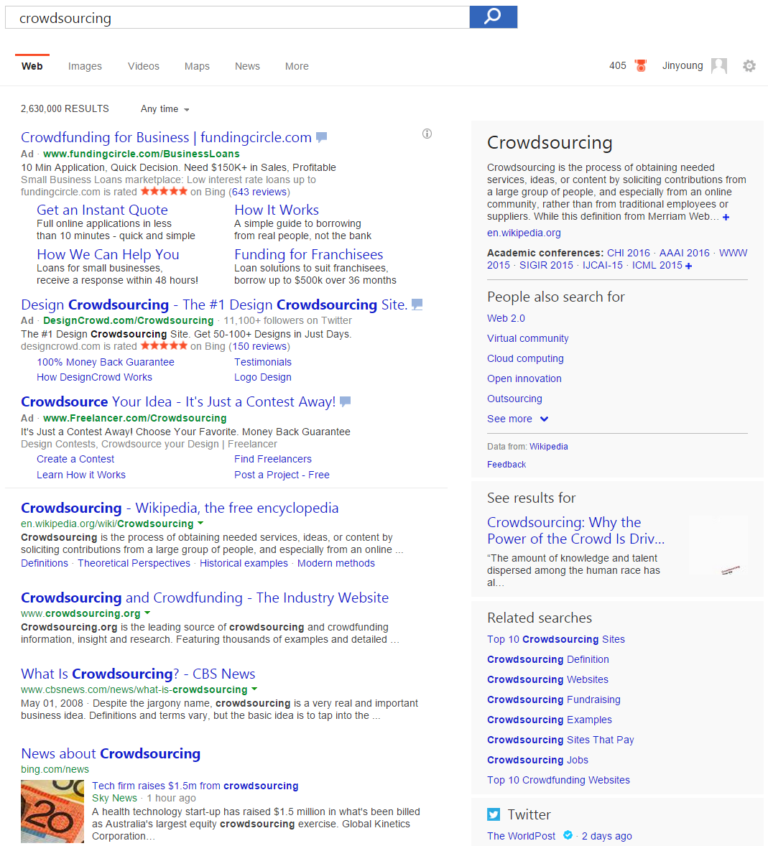
What constitutes a task?
Goal
You want to evaluate the target for task description provided
Task description
Some (expression of) information need
Search query / user profile / …
Target
System response to satisfy the need
SERP / webpage / answer / …

Slide 10
Sampling tasks (queries)
Random sample of user query is common method
What can go wrong in this approach?
Sampling criteria
Representative: Are the samples representative of the user traffic?
Actionable: Are they targeted for what we’re trying to improve on?
Need for more context
Are queries specific enough for consistent judgment?

Slide 11
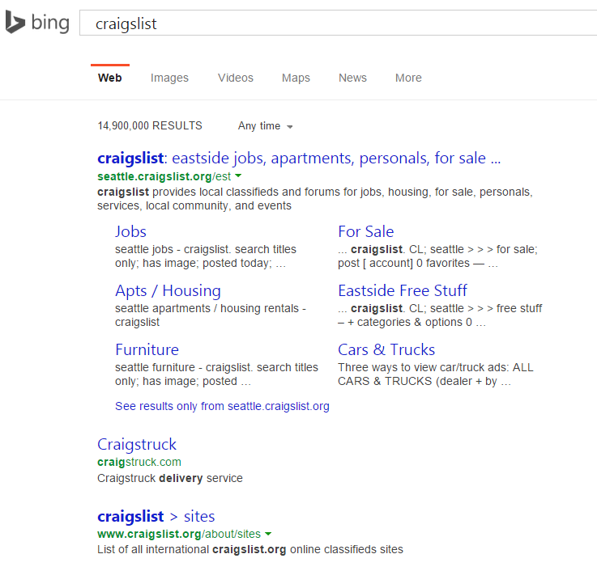
Add contexts if query alone is not enough
Context examples:
User’s location
Task description
Session history
…
Cost of contextual judging
Potentially need more judgments
Increase judge’s cognitive load
Notes:
Mention TREC topic desc.

Slide 12
Designing a judging interface

Slide 13
Goals in designing a judging interface
Maximum information
Minimum efforts
Minimum errors

Slide 14
Designing a judging interface: SERP*
Q: How would you rate the search results?
Not Relevant
Fair
Good
Excellent
Q: Why do you think so?
Questions
Responses
Judging Target
*SERP: Search Engine Results Page
Notes:
No ground for comparison / What if the judge doesn’t understand the intent?

Slide 15
Practice: Design your own Judging Interface
What can go wrong with the evaluation interface?
How can you improve the evaluation interface?

Slide 16

What can go wrong here?
Judges may like some part of the page, but not others
Judges may not understand the query at all
Each judge may understand the task differently
Rating can be very subjective without a clear baseline
…

Slide 17
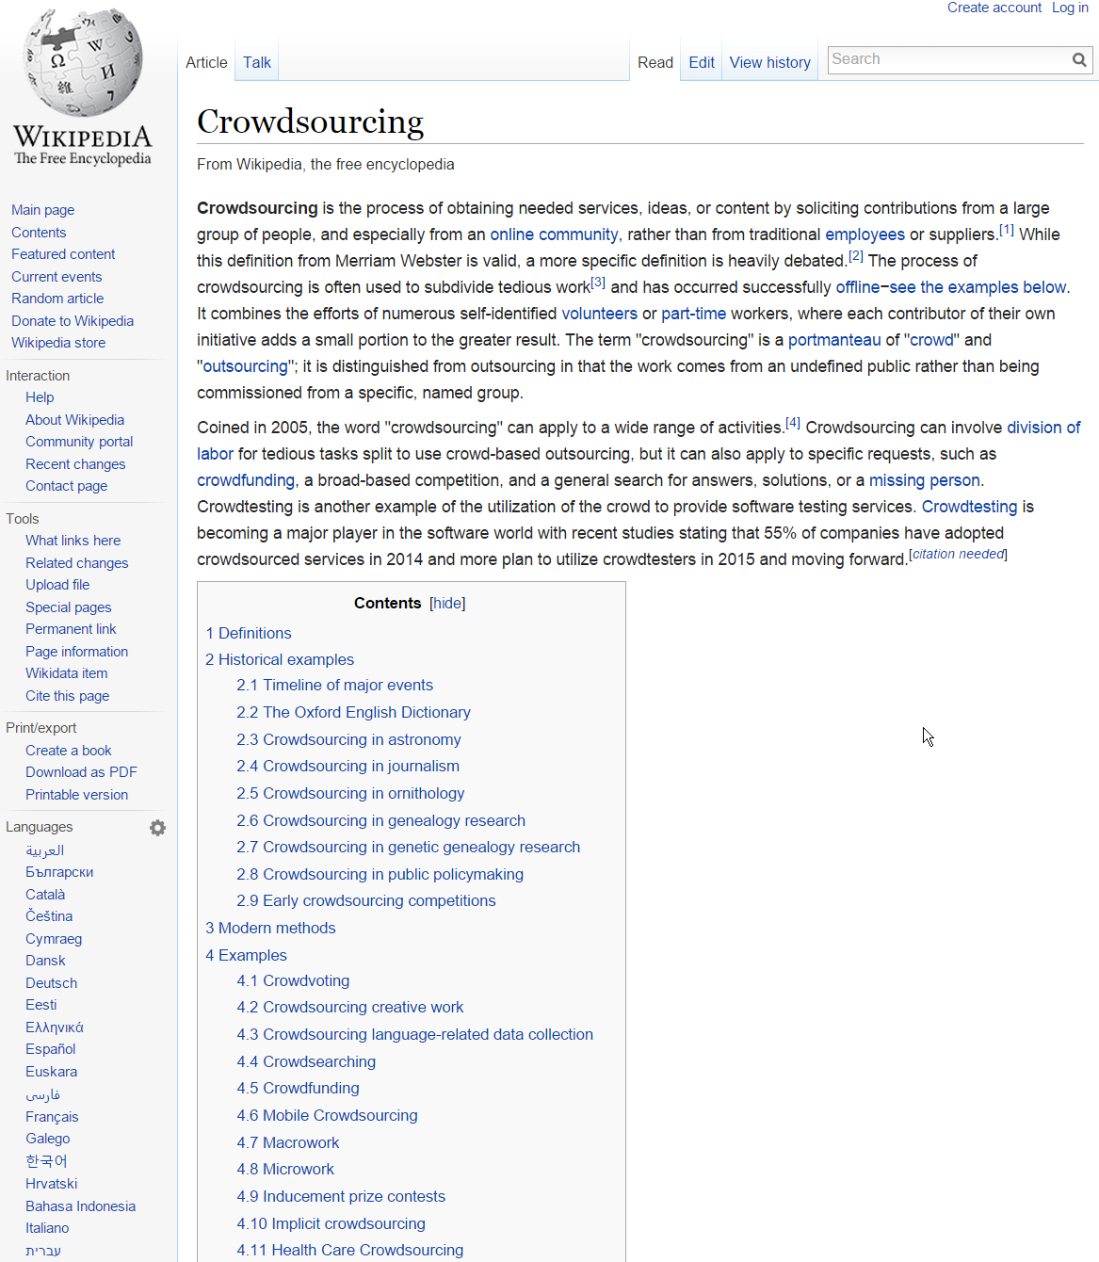
Designing a judging interface: web result
Given ‘crowdsourcing’ as a query, how would you rate the webpage?
Not Relevant
Fair
Good
Excellent
Q: Why do you think so?
Now the judging target is specific enough
Notes:
No ground for comparison / What if the judge doesn’t understand the intent?

Slide 18
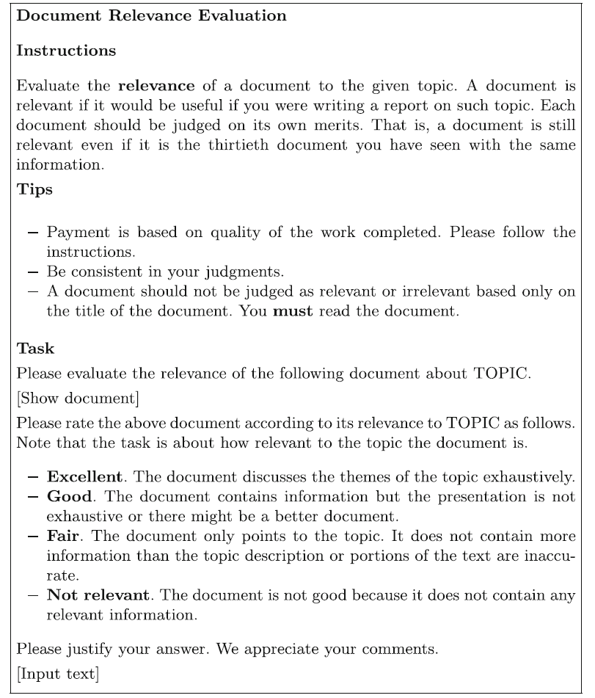
Judging Guideline
A document for judges to read before starting the task
Need to keep simple (i.e., one page), especially for crowd judges
Can’t rely on the guideline for all instructions: use training / tooltips

Slide 19
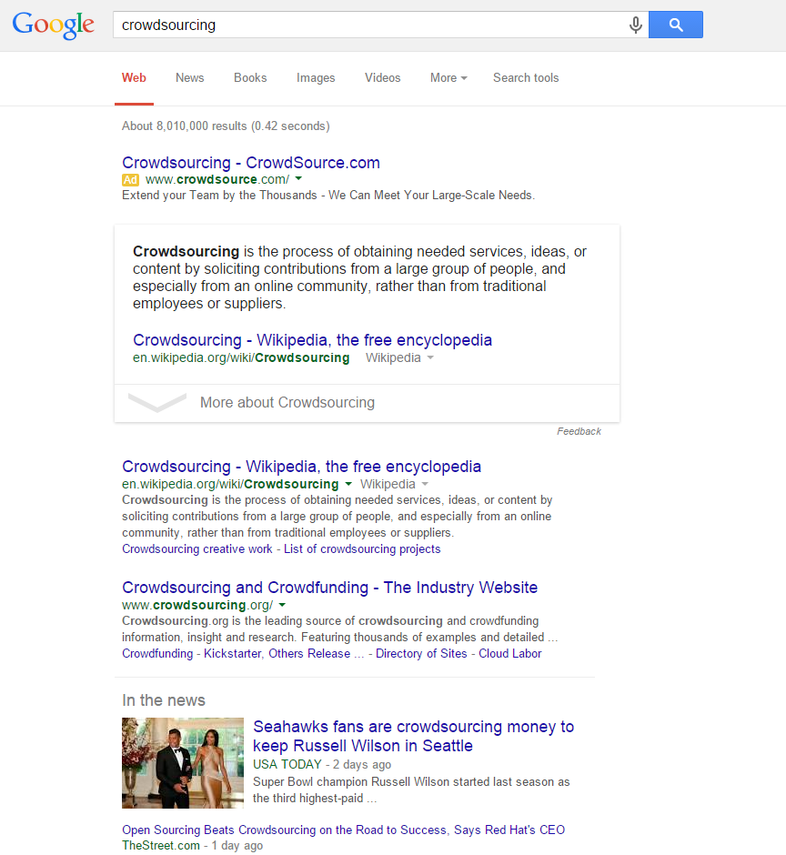
Designing a judging interface: side-by-side
Q: How would you compare two results?
Left much better
Left better
About the same
Right better
Right much better
Q: Why do you think so?
The other page establishes a clear baseline for the judgment
Notes:
Should we use ‘about the same’ vs. ‘the same??

Slide 20
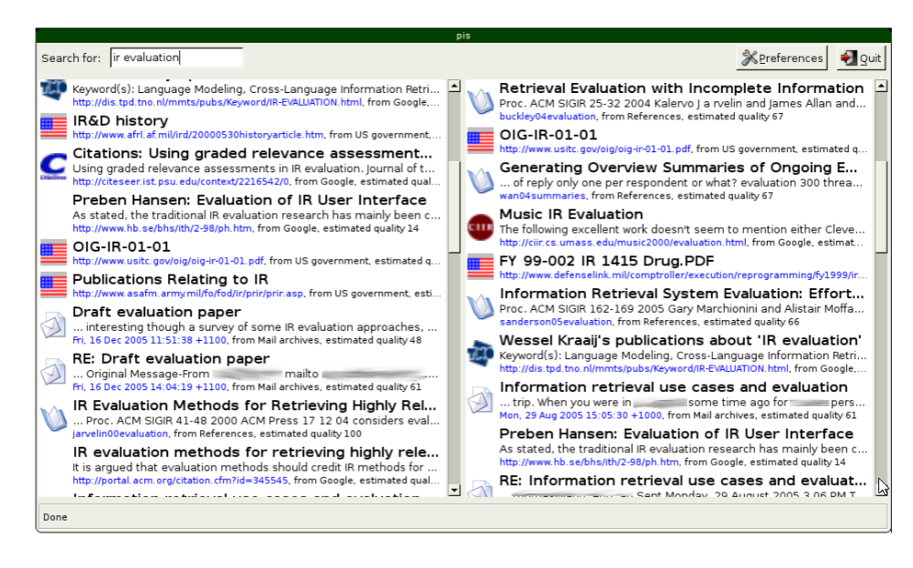
Evaluation by Comparing Result Sets in Context
[Thomas’06]

Slide 21
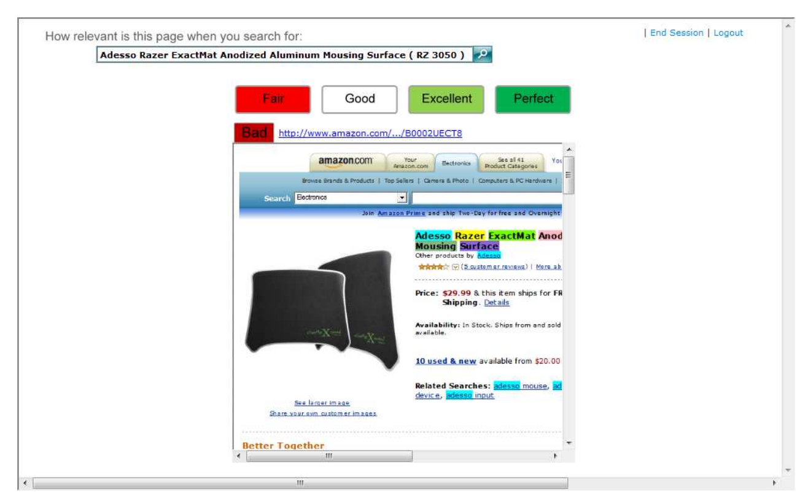
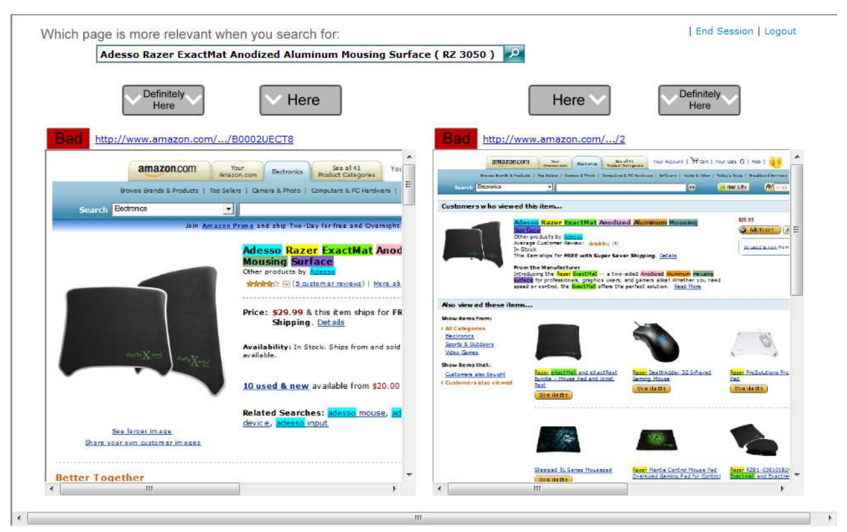
Here or There: Preference Judgments for Relevance _{[Carterette et al. 2008]}
Higher inter-judge agreement in preference judgement

Slide 22
Tips on judging interface design
Use plain language (i.e., avoid jargons)
Make the UI light and simple (e.g., no scroll)
Put ‘I don’t know’ (skip) option (to avoid random responses)
Collect optional textual comments (for rationale or feedback)
Collect judging time and behavioral log data (for quality control)

Slide 23
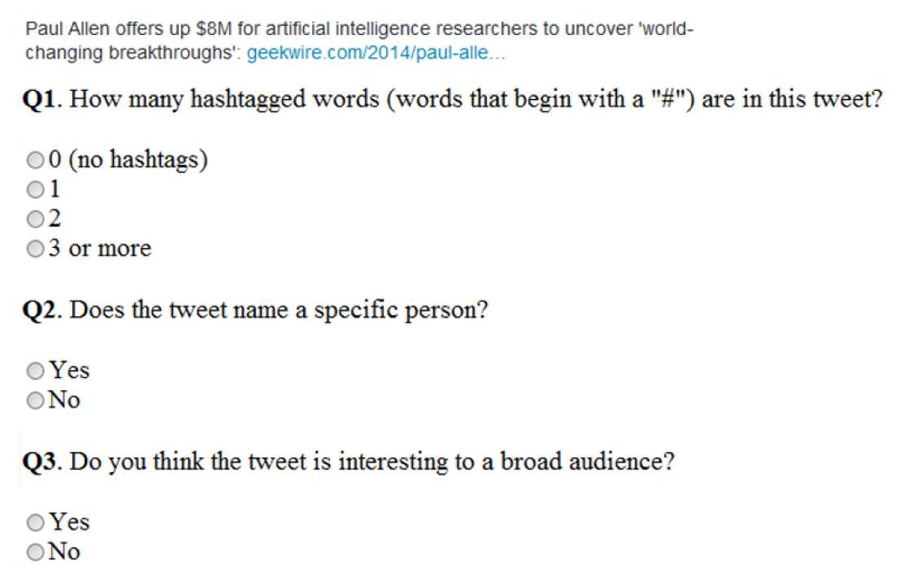
Using Hidden Tasks for Quality Control _{[Alonso ’15]}
Ask simple questions that require judges to read the contents
This prepare the judge for actual judging task
This provide ways to verify if the response is bogus

Slide 24
Designing an experiment
Notes:
One judgment is not enough!

Slide 25
From judgments to an experiment
Experiment
A set of judgments collected with a particular goal
A typical experiment consists of many tasks and judgments
Multiple judgments are collected for each task (overlap)
Types of goals
Resource planning: where to invest in next few months?
Feature debugging: what can go wrong with this feature?
Shipping decision: should we ship the feature to the production?
Judgments
Tasks
9 tasks X 3 overlap

Slide 26
Breakdown of Experimental Cost
How much money (time) spent per task?
How many (overlap) judgments per task?
How many tasks within experiment?
Judgments
10 | 10 | 10
10 | 10 | 10
10 | 10 | 10
10 | 10 | 10
10 | 10 | 10
10 | 10 | 10
10 | 10 | 10
10 | 10 | 10
10 | 10 | 10
Tasks
$ (time) per Judgment
# Judgments per Task
# Tasks within Experiment
10 cent = 30 second
(12$/HR)
3 judgments per task
9 tasks
Total cost: 2.7$
Notes:
Pay per task: how much of judges’ time do you want to borrow?

Slide 27
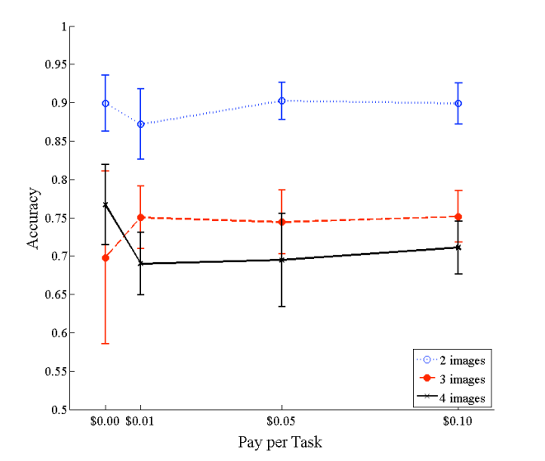
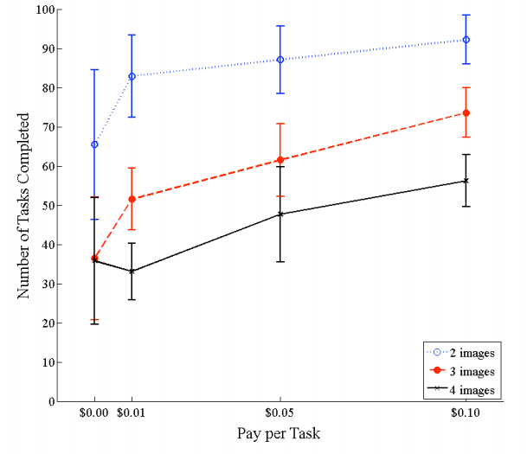
Effect of Pay per Task
[Mason and Watts, 2009]
Higher pay per task doesn’t improve judging quality, but throughput

Slide 28
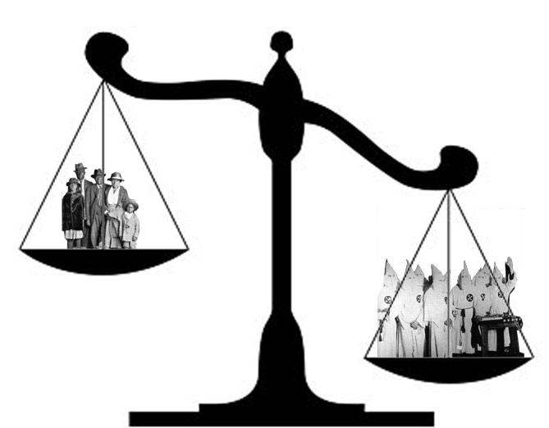
Why overlap judgments?
Better task understanding
What’s the distribution of labels?
What are judges’ collective feedback?
Quality control for labels / judges
What is the majority opinion for each task?
Who tends to disagree with the majority opinion?
Majority opinion is not always right, especially before you have enough of good judges

Slide 29
Majority Voting and Label Quality
[Kuncheva et al., PA&A, 2003]
Ask multiple labellers, keep majority label as “true” label
Quality is probability of being correct
p: probability
of individual labeller being correct

Slide 30
High vs. Low overlap experiment
High-overlap
Early iteration stage
Information-centric tasks
Low-overlap
Mature / production stage
Number-centric tasks
Judgments
Judgments
Tasks
Tasks
3 tasks X 9 overlap
9 tasks X 3 overlap
Notes:
Different layout?

Slide 31
Summary: Evaluation Goals & Guidelines
Evaluation Goal | Judgment Design | Experiment Design
Feature Planning / Debugging | Label + Comments | Information-centric (High overlap)
Training Data | Label + Comments | Specific to the algorithm
Shipping Decision (ExpA vs. ExpB) | Label + Comments | Number-centric (Low overlap)

Slide 32
Running the experiment

Slide 33
Choosing judge pools
Ground Truth Judgments
Development Team
In-house (managed) judges
Crowdsourcing judges
Ground Truth Judgments
Ground Truth Judgments
Less expertise
More judgments
Closer to users
Collect ground truth labels for next stage
Notes:
Dev team should definitely be the first judges

Slide 34

Choosing judge within the pool
Considerations
Do judges have necessary knowledge?
Do judge profiles match with target users?
Can they perform the task with reasonable accuracy?
Methods
Pre-screen judges by profile
Filter out judges by screening task
Kick off ‘bad’ judges regularly
Notes:
Screenshot?

Slide 35
Training judges: Training tasks
Given ‘crowdsourcing’ as a query, how would you rate the webpage?
Bad
Fair
Good
Excellent
Perfect
Q: Why do you think so?
Initial qualification task
Interleaved training task
Interleaved QA task
The Answer is ‘Excellent’
This document satisfies user’s main intent by providing well curated information about the topic
Notes:
Tasks with known answers are interleaved with regular tasks

Slide 36
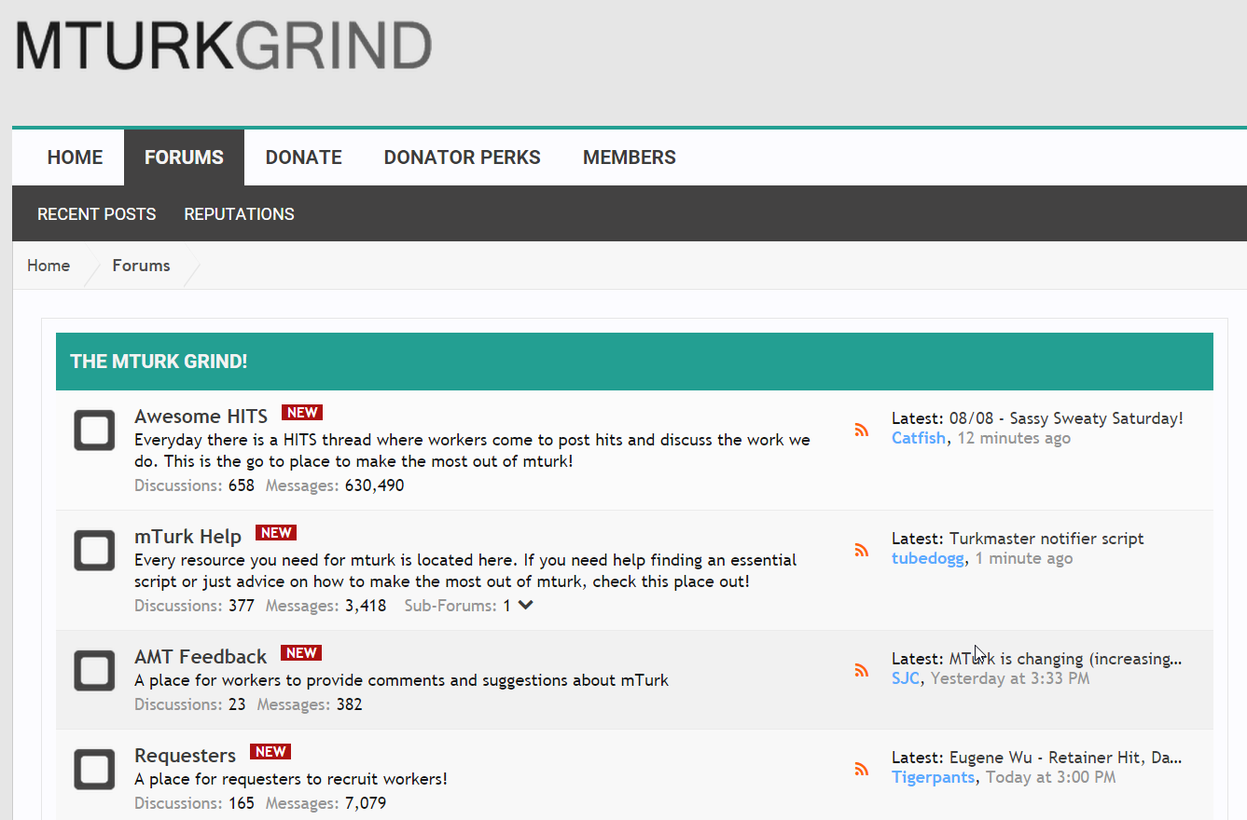
Crowd workers communicate with each other!
You need to manage your reputation as a requester.
(Quick payment / Responsive to workers’ feedback)
Answers shared with one worker is likely shared with all.

Slide 37
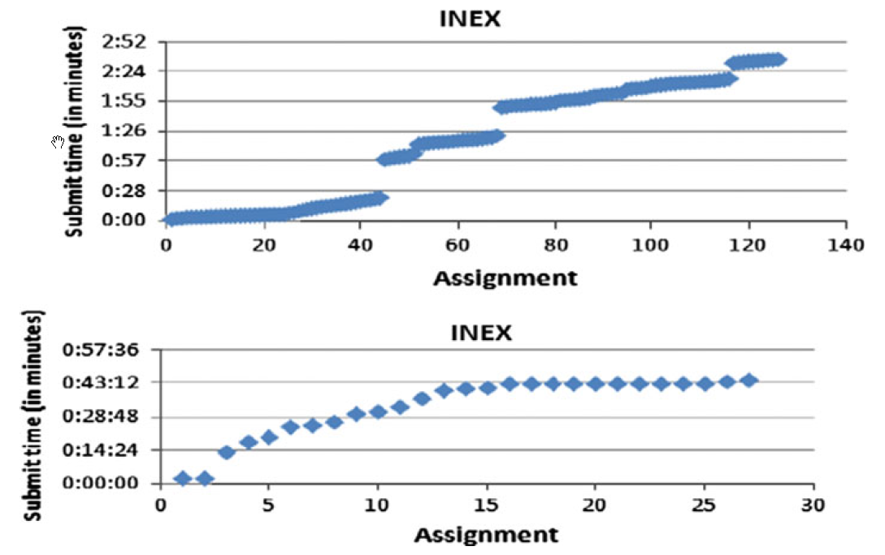
Cost of Qualification Test _{[Alonso’13]}
Judges become an order of magnitude slower under the presence of qualification tasks
However, depending on the type of task, the results may worth the delay and cost

Slide 38

Tips on running an experiment
Scale up judging tasks slowly
Beware of the quality of golden hits
Submit a big task in small batches (for task debugging / judge engagement)
Monitor & respond to judges’ feedback
Notes:
Judges need regular stream of jobs to stick to

Slide 39
Evaluating the Experiment

Slide 40
Analyzing the judgment quality
Agreement with ground truth (aka golden hits)
Inter-rater agreement
Behavioral signals (time, label distribution)
Agreement with other metrics

Slide 41
Comparing Inter-rater Metrics
Percentage agreement: the ratio the cases that received the same rating by two judges and divides the number by the total number of cases rated by the two judges.
Cohen’s kappa. estimate the degree of consensus between two judges by correcting if they are operating by chance alone.
Fleiss’ kappa: generalization of Cohen to n raters instead of just two.
Krippendorff’s alpha: accept any number of observers, being applicable to nominal, ordinal, interval, and ratio levels of measurement
https://en.wikipedia.org/wiki/Inter-rater_reliability

Slide 42
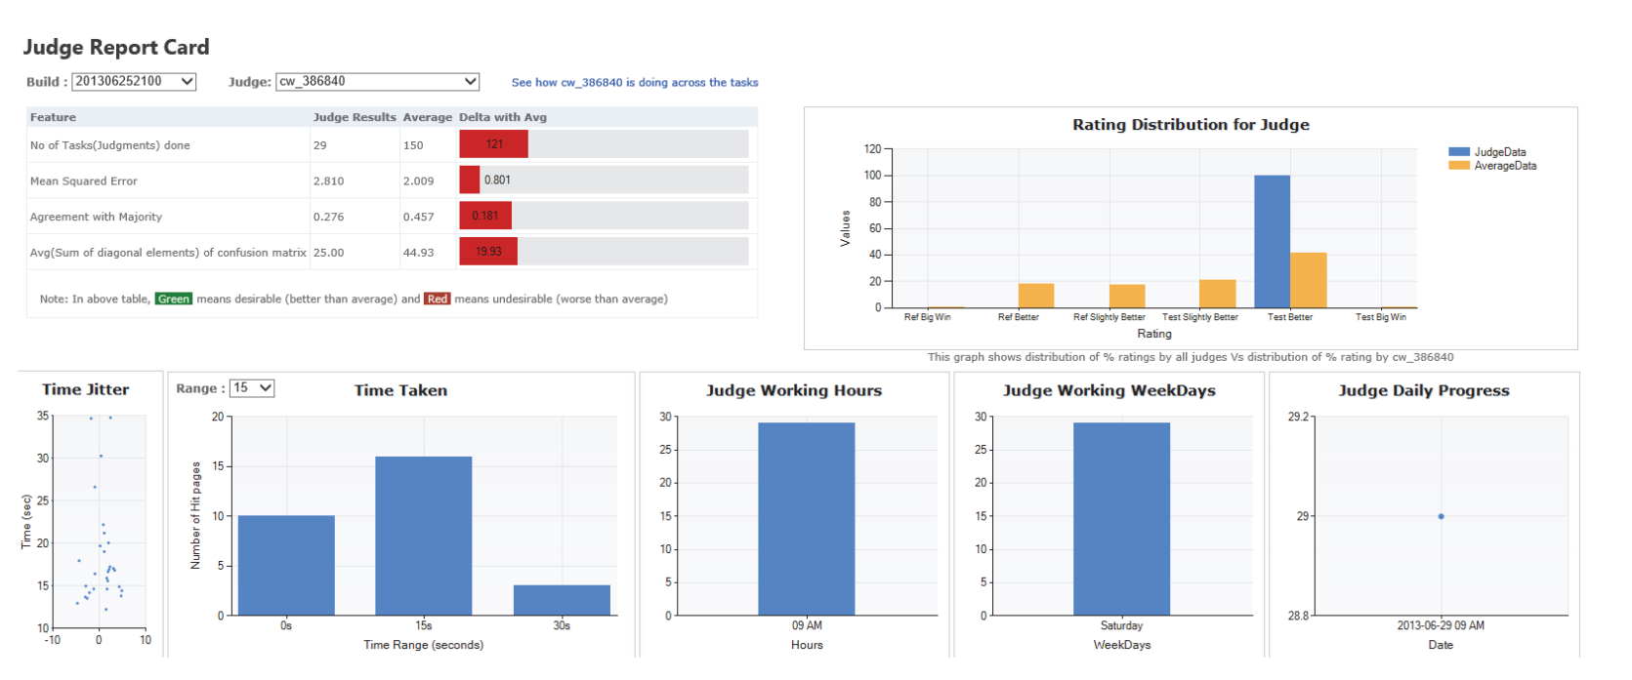
Analyzing the judgment quality
Automating Crowdsourcing Tasks in an Industrial Environment
Vasilis Kandylas, Omar Alonso, Shiroy Choksey, Kedar Rudre, Prashant Jaiswal

Slide 43
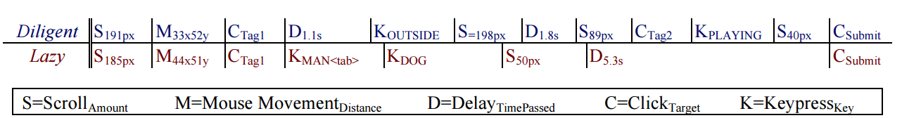
Using Behavior of Crowd Judges for QA
Predictive models of task performance can be built based on behavioral traces, and that these models generalize to related tasks.
Instrumenting the Crowd: Using Implicit Behavioral Measures to Predict Task Performance, UIST’11, Jeffrey M. Rzeszotarski, Aniket Kittur

Slide 44
Case Study: Relevance Dimensions in Preference-based IR Evaluation _{[Kim et al. ’13]}
Q: How would you compare two results?
Overall
Relevance
Diversity
Freshness
Authority
Caption
Q: Why do you think so?
Left Tie Right
Allow judges to break down their judgments along several dimensions

Slide 45
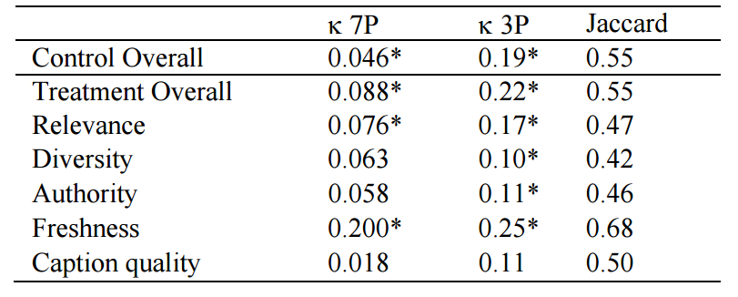
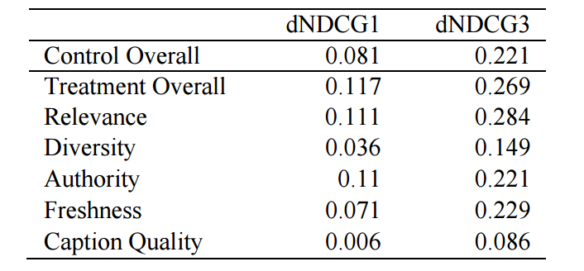
Case Study: Relevance Dimensions in Preference-based IR Evaluation _{[Kim et al. ’13]}
Inter-judge Agreement
Preference judgments vs. Delta in NDCG@{1,3} correlation
All achieved with 10% increase in judging time

Slide 46
Conclusions

Slide 47
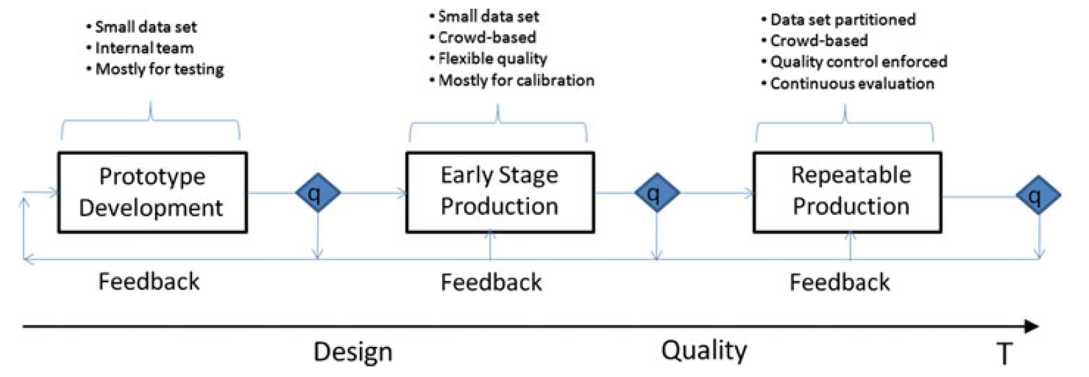
Building a Production Evaluation Pipeline
Omar Alonso, Implementing crowdsourcing-based relevance experimentation: an industrial perspective. Inf. Retr. 16(2): 101-120 (2013)

Slide 48
Recap: Steps for Offline Evaluation
Preparing tasks
Designing a judging interface
Designing an experiment
Running the experiment
Evaluating the Experiment
Notes:
For the rest of this talk, I’ll follow the steps for …

Slide 49
Main References
Implementing crowdsourcing-based relevance experimentation: an industrial perspective. Omar Alonso
Tutorial on Crowdsourcing Panos Ipeirotis
Amazon Mechanical Turk: Requester Best Practices Guide
Quantifying the User Experience. Sauro and Lewis. (book)

Slide 50
Optional

Slide 51
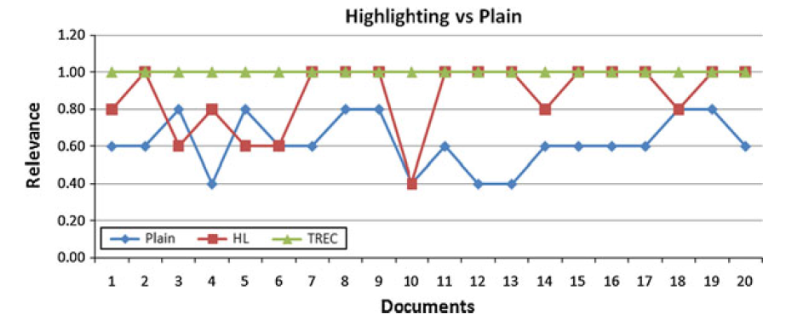
Impact of Highlights on Document Relevance
Highlighted versions of the document were perceived to be more relevant to plain versions. _{[Alonso, 2013]}
Subtle interface change can affect the outcome significantly
Notes:
Need to be careful if you want to change the judging interface suddenly…

Slide 52
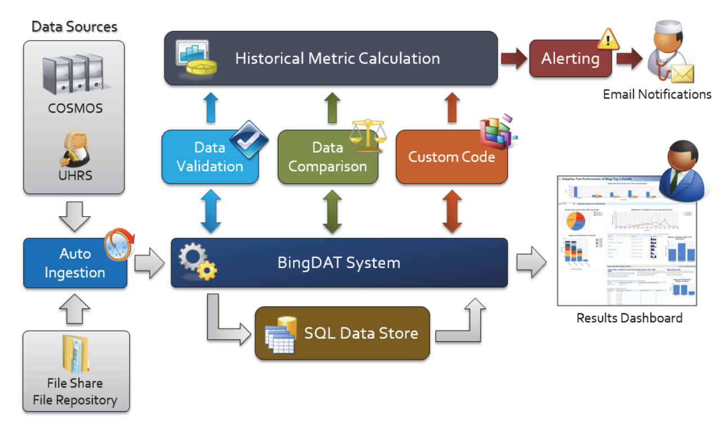
Architecture Example: BingDAT
Automating Crowdsourcing Tasks in an Industrial Environment
Vasilis Kandylas, Omar Alonso, Shiroy Choksey, Kedar Rudre, Prashant Jaiswal

Slide 53
Computing Cohen’s Kappa

Slide 54
Computing Quality Score: Cohen’s Kappa
Statistic used for measuring inter-rater agreement
Can be used to measure
Agreement with gold data
Agreement between two workers
More robust than error rate as it takes into account agreement by chance
Pr(a): Observed agreement among raters
Pr(e): Hypothetical probability of chance of agreement (agreement due to chance)

Slide 55
Computing Cohen’s Kappa
Computing probability of agreement (Pr(a))
Generate the contingency table
Compute number of cases of agreement/ total number of ratings
Worker 1
Total:
13
14
9
a b c
a
b
c
9 | 3 | 1
4 | 8 | 2
2 | 1 | 6
Worker 2
Total: 15 12 9 Overall total: 36

Slide 56
Computing Cohen’s Kappa
Computing probability of agreement (Pr(a))
Generate the contingency table
Compute number of cases of agreement/ total number of ratings
Worker 1
Total:
13
14
9
a b c
a
b
c
9 | 3 | 1
4 | 8 | 2
2 | 1 | 6
Pr(a) = (9+8+6)/36 = 23/36
Worker 2
Total: 15 12 9 Overall total: 36

Slide 57
Computing Cohen’s Kappa
Computing probability of agreement due to chance
Compute expected frequency for agreements that would occur due to chance
What is the probability that worker 1&worker 2 both label any item as an a?
What is the expected number of items labelled as a by both worker 1 and worker 2?
Worker 1
Total:
13
14
9
a b c
a
b
c
9 | 3 | 1
4 | 8 | 2
2 | 1 | 6
Pr(w1=a&w2=a) = (15/36)*(13/36)
E[w1=a&w2=a] = (15/36)*(13/36)*36
= 5.42
Worker 2
Total: 15 12 9 Overall total: 36

Slide 58
Computing Cohen’s Kappa
Computing probability of agreement due to chance
Compute expected frequency for agreements that would occur due to chance
What is the probability that worker 1&worker 2 both label any item as an a?
What is the expected number of items labelled as a by both worker 1 and worker 2?
Worker 1
Total:
13
14
9
a b c
a
b
c
9 (5.42) | 3 | 1
4 | 8 | 2
2 | 1 | 6
Pr(w1=a&w2=a) = (13/36)*(15/36)
E[w1=a&w2=a] = (13/36)*(15/36)*36
= 5.42
Worker 2
Total: 15 12 9 Overall total: 36

Slide 59
Computing Cohen’s Kappa
Computing probability of agreement due to chance
Compute expected frequency for agreements that would occur due to chance
What is the probability that worker 1&worker 2 both label any item as an a?
What is the expected number of items labelled as a by both worker 1 and worker 2?
Worker 1
Total:
13
14
9
a b c
a
b
c
9 (5.42) | 3 | 1
4 | 8 (4.67) | 2
2 | 1 | 6 (2.25)
Pr(w1=a&w2=a) = (13/36)*(15/36)
E[w1=a&w2=a] = (13/36)*(15/36)*36
= 5.42
Worker 2
Total: 15 12 9 Overall total: 36

Slide 60
Computing Cohen’s Kappa
Computing probability of agreement due to chance
Compute expected frequency for agreements that would occur due to chance
What is the probability that worker 1&worker 2 both label any item as an a?
What is the expected number of items labelled as a by both worker 1 and worker 2?
Worker 1
Total:
13
14
9
a b c
a
b
c
9 (5.42) | 3 | 1
4 | 8 (4.67) | 2
2 | 1 | 6 (2.25)
Pr(e) = (5.42+4.67+2.25)/36
Worker 2
Total: 15 12 9 Overall total: 36

Slide 61
Computing Cohen’s Kappa
Computing probability of agreement due to chance
Compute expected frequency for agreements that would occur due to chance
What is the probability that worker 1&worker 2 both label any item as an a?
What is the expected number of items labelled as a by both worker 1 and worker 2?
Worker 1
Total:
13
14
9
a b c
a
b
c
9 (5.42) | 3 | 1
4 | 8 (4.67) | 2
2 | 1 | 6 (2.25)
Pr(e) = 12.34/36
Pr(a) = 23/36
Kappa = (23-12.34)/(36-12.34) = 0.45
Worker 2
Total: 15 12 9 Overall total: 36

Slide 62
What is a good value for Kappa?
Kappa >= 0.70 => reliable inter-rater agreement
For the above example, inter-rater reliability is not satisfactory
If Kappa<0.70, need ways to improve worker quality
Better incentives
Better interface for the task
Better guidelines/clarifications for the task
Training before the task…

Slide 63
Calculating the Confidence Interval

Slide 64
Drawing Conclusions
Hypothesis testing (covered in Part I)
How confident can we be about our conclusion?
Confidence interval
How big is the improvement?
How precise is our estimate?
Both statistical significance and confidence interval should be reported!
Notes:
These can be derived from the sampling distribution

Slide 65
Confidence Interval and Hypothesis Testing
Confidence Interval
Does the 95% C.I. of sample mean include zero?
Hypothesis Testing
Does 95% C.I. under H0 include the critical value ?
0
Sample Mean
95% Confidence Interval
0
Critical Value
95% Conf. Int. under H0

Slide 66
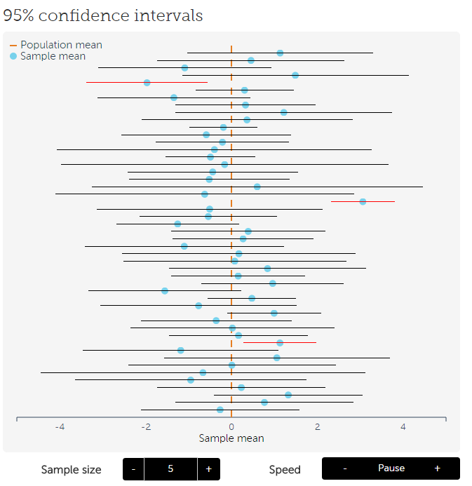
Sampling Distribution and Confidence Interval
95% confidence interval: 95% of sample means will fall under this interval
This means 95% of sample will include the mean of original sample
http://rpsychologist.com/d3/CI/
Notes:
, which is our best guess for the population mean

Slide 67
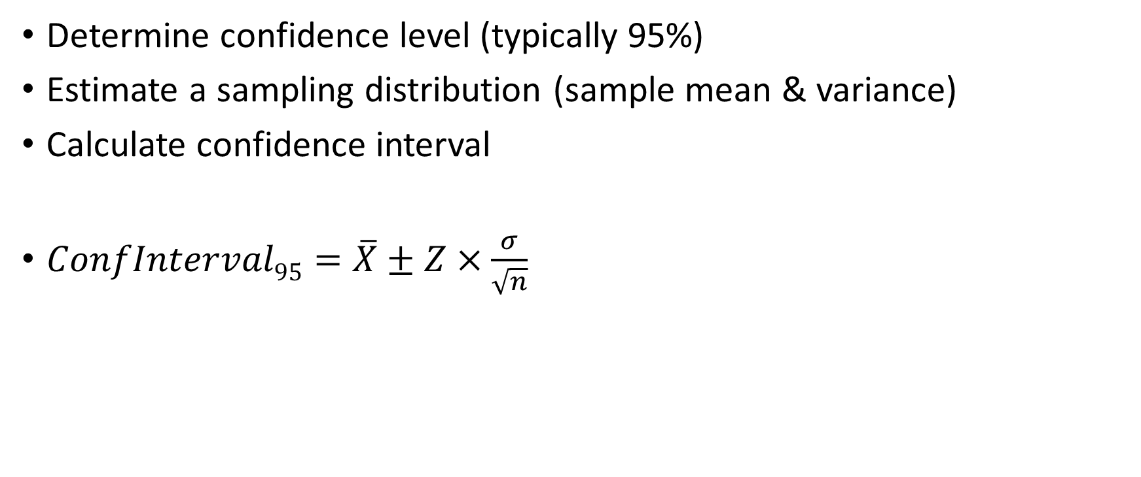
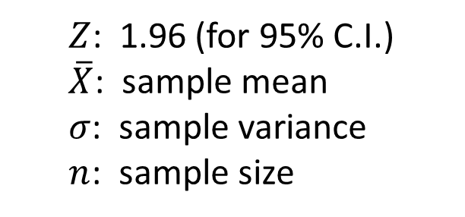
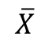
Computing the Confidence Interval
Determine confidence level (typically 95%)
Estimate a sampling distribution (sample mean & variance)
Calculate confidence interval
$ConfInterval95=\overline{X}±Z×\frac{σ}{\sqrt{n}}$
Sampling Distribution
$Z$: 1.96 (for 95% C.I.)
$\overline{X}$: sample mean
$σ$: sample variance
$n$: sample size
$$\overline{X}$$
95% Confidence Interval
Notes:
If you flip this, you can have hypothesis testing

